Slide 1

ENERGY

Slide 2
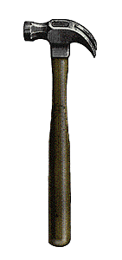


ENERGY is…
the ability to do WORK or cause change
WORK is…
when a FORCE moves an object
a FORCE is…
a push or a pull

Slide 3
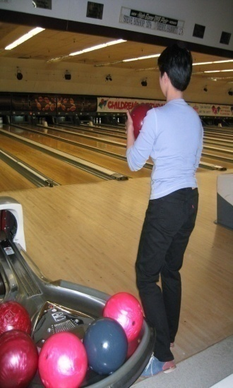
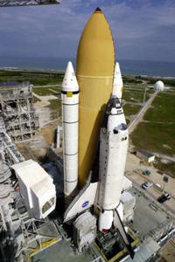
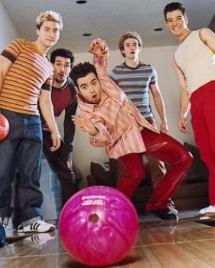

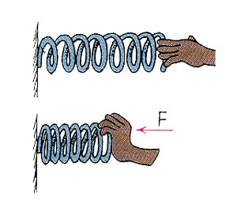
There are two main kinds of energy…
POTENTIAL ENERGY
KINETIC ENERGY
STORED energy
or
Energy that is NOT being used
Energy in MOTION
or
Energy that IS being used
Examples:
Examples:

Slide 4
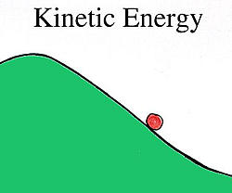

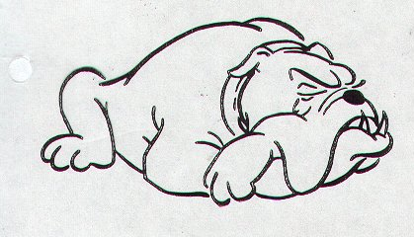

Write a “P” or a “K” under each picture on your paper to tell whether the pictures are showing POTENTIAL or KINETIC energy.
zzzz
K

Slide 5
Elastic Potential Energy
Elastic potential energy is associated
with objects that can be stretched
or compressed.
Elastic potential energy can be stored in rubber bands, bungee chords, trampolines, springs, an arrow drawn into a bow, etc.

Slide 6
Gravitational Potential Energy
Gravitational Energy is the energy of
position or place. A rock resting at the top
of a hill contains gravitational potential energy.
Hydropower, such as water in a reservoir behind
a dam, is an example of gravitational potential energy.

Slide 7
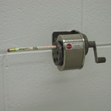
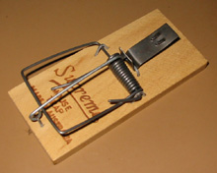
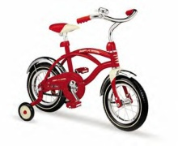
DIFFERENT FORMS OF ENERGY
Both potential & kinetic energy come in many forms. Six of the most common ones are:
MECHANICAL ENERGY
Energy of moving parts
THERMAL (HEAT) ENERGY
Energy of the heat IN an object
CHEMICAL ENERGY
Energy in chemical bonds of food, gas, batteries, burning wood etc.

Slide 8
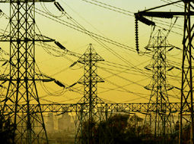

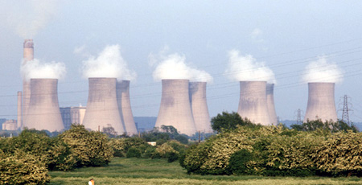
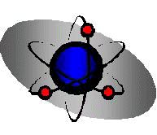
DIFFERENT FORMS OF ENERGY (continued)
ELECTRICAL ENERGY
Moving electrical charges
ELECTROMAGNETIC ENERGY
Light energy, X-rays, radio waves
NUCLEAR ENERGY
Stored in the nucleus of an atom & released when atoms are split or joined together, nuclear reactors, atomic bombs, stars, sun

Slide 9
ENERGY CONVERSIONS (ENERGY TRANSFORMATIONS)
Energy can be converted (transformed or changed) from one form to another.
For example…
1) Food has POTENTIAL CHEMICAL energy.
2) When you eat it, the bonds in the atoms are broken and the energy is released to your cells.
Your body CHANGES the chemical energy to KINETIC MECHANICAL ENERGY when you run, jump, write, walk.
4) Finally, your body creates THERMAL (HEAT) ENERGY you can feel because the molecules inside you are moving!

Slide 10

Think about the energy conversions taking place with a flashlight.
Light & Heat
Batteries
Wires
CHEMICAL ENERGY
ELECTRICAL ENERGY
ELECTROMAGNETIC ENERGY

Slide 11
ELECTRIC PENCIL SHARPENER
WIRES
GEARS & BLADES
electrical energy
mechanical energy

Slide 12
HEATING PAD
WIRES
HEAT
electrical energy
thermal energy

Slide 13
PLANT
PHOTOSYNTHESIS
SUN
Plant changes sunlight and water into sugar (food) for plant!
electromagnetic
energy
chemical
energy

Slide 14
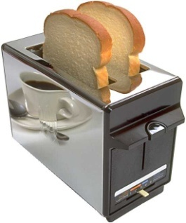
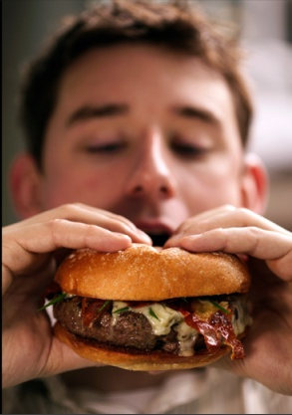
Electrical Energy into Thermal Energy
Chemical Energy into Mechanical Energy
Energy Transformations
Conversions Between Forms of Energy
  A change from one form of energy to another is called energy conversion.
  Most forms of energy can be converted into any other form.
  Ex. Toaster converts electrical energy to thermal energy. Your body converts chemical energy in the food you eat into the mechanical energy you need to move your muscles.
  Usually heat energy is also formed in an
  energy conversion.
Notes:
STOP HERE! Use the rest of this slide show later.

Slide 15
Energy Conversion in a Pendulum
  A continuous conversion between kinetic and potential energy takes place in a pendulum.
  At the highest point in its swing, the pendulum has only potential energy. As it starts to swing downward, it speeds up and its potential energy changes to kinetic energy
Potential
Energy

Slide 16
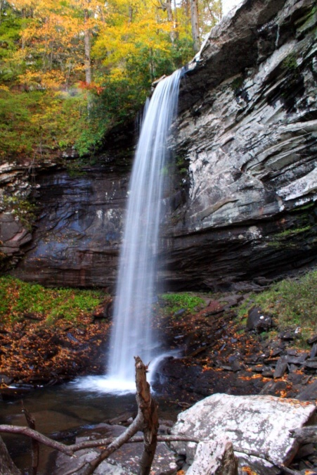
Energy Conversion in a Waterfall
    The water at the top of the falls has gravitational potential energy because it is higher than at the bottom. As the water falls, its height decreases, and loses its potential energy. At the same time, its kinetic energy increases because its velocity (speed) increases. The potential energy is converted into kinetic energy.
Gravitational
Potential
Energy
Kinetic Energy

Slide 17
Law of Conservation
  The law of conservation of energy states that when one form of energy is converted to another, no energy is destroyed in the process.
  Energy cannot be created or destroyed, so the total amount of energy is the same before and after any process. All energy is accounted for.
Conserving Energy
When you hear or read about conserving energy, don’t get confused with the law of conservation of energy. Conserving energy means saving energy, or not wasting it!
In Science, energy is always conserved because its total quantity does not change.
http://tonto.eia.doe.gov/kids/energy.cfm?page=about_home-basics

Slide 18
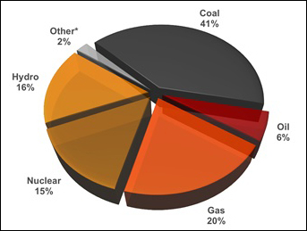
Generating Electricity
World Electricity Generation
Notes:
LG: to compare different methods of electricity generation

Slide 19
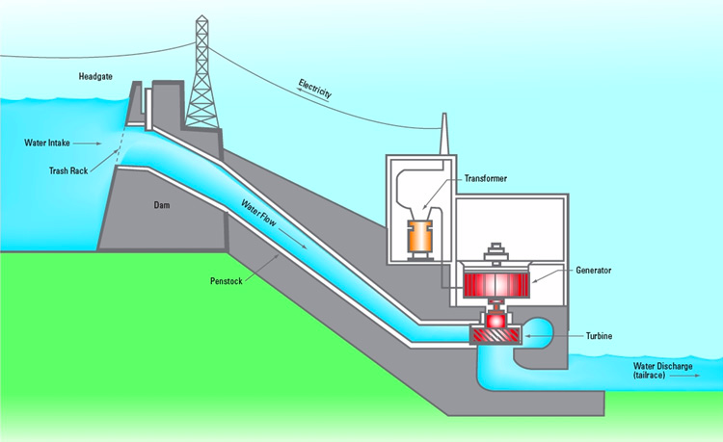
Generating Electricity
Electricity Generation: electrical energy has to be made by conversion from some other form of energy

Slide 20
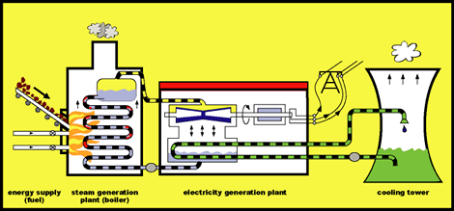
electricity school house rock
Where do we get electricity?
Energy conversions from fossil fuel:

Slide 21
Generating Electricity
thermal generation
-water is heated to make steam
-pressure builds & the steam can only escape by passing through a turbine
-this turns the turbine

Slide 22
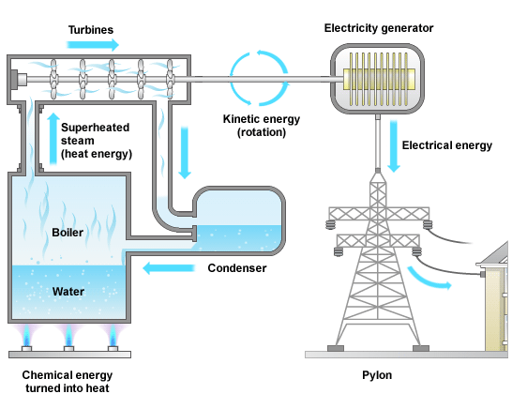
Generating Electricity

Slide 23
Generating Electricity
thermal generation
Fossil Fuel: burning coal, oil, or natural gas can be used to heat the water
Radioactive Material: when the nuclei of uranium atoms break apart huge amounts of energy is released, which can be used to heat the water
Biomass: biodegradable wastes can be burned to heat the water

Slide 24
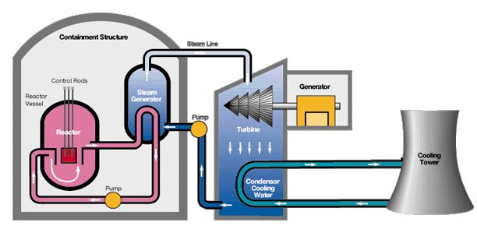
Electricity from Nuclear energy

Slide 25
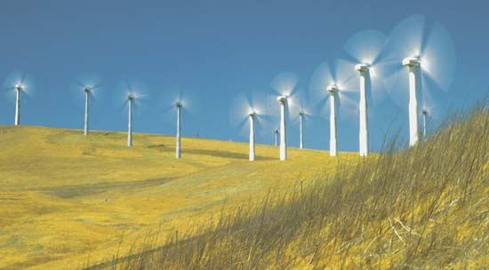
Electricity from Wind energy

Slide 26
Generating Electricity
Electricity Generation: electrical energy has to be made by conversion from some other form of energy
e.g. Wind
-the blades themselves act as a turbine to turn the middle of the generator to produce electricity
called wind turbines, not wind mills
wind turbine video

Slide 27
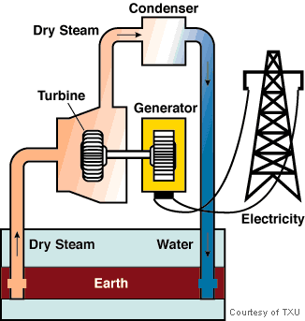
Electricity from geothermal

Slide 28

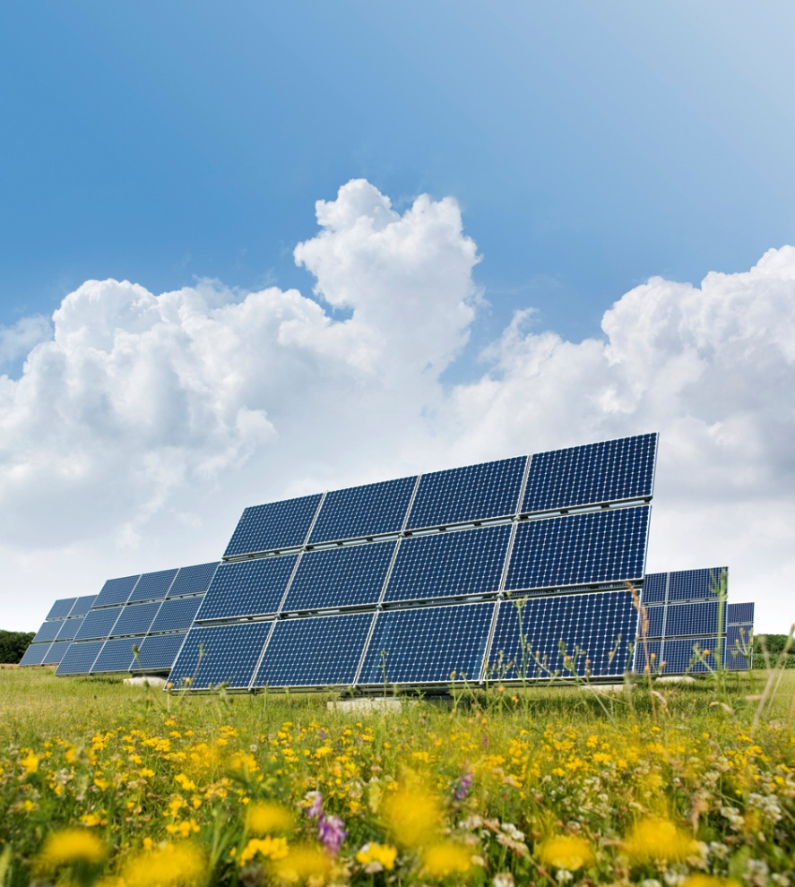
Electricity from the sun

Slide 29
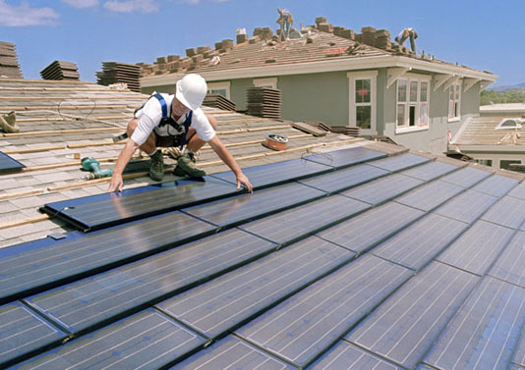
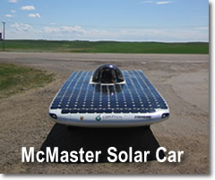
Generating Electricity
Electricity Generation: electrical energy has to be made by conversion from some other form of energy
e.g. Light
photovoltaic cells: converts light directly into electrical energy
LG: to compare different methods of electricity generation

Slide 30
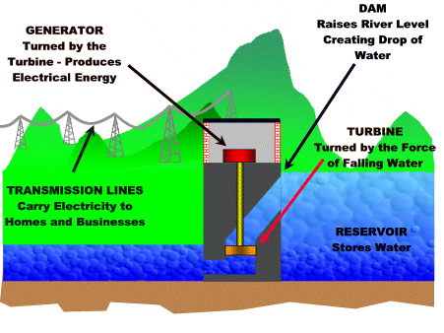
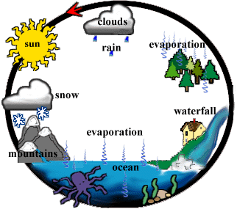
Electricity from hydropower

Slide 31
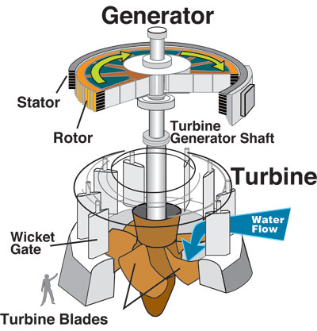
Generating Electricity
hydroelectric generation
Turbine:
a fan-like device
which turns in response
to the pressure of falling
water
or
a coil of wire
turned inside a magnet
generates electricity

Slide 32
Generating Electricity
hydroelectric generation
Power lines: electricity
generated is carried in
wires over long distances
to our homes

Slide 33
Generating Electricity
Electricity Generation: electrical energy has to be made by conversion from some other form of energy
e.g. tidal generation
-high & low tides occur twice daily
-tidal water movement can be used to turn a
turbine
LG: to compare different methods of electricity generation

Slide 34
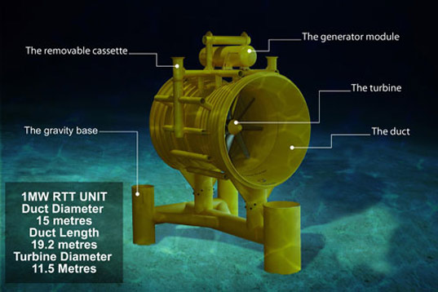
Generating Electricity

